Slide 1
Health Care In Sweden
Rose Patrick
Spring 2022

Slide 2
Glossary
3 – Culture and Ethnic Identity
4 – Communication
5 – Family Relationships
6 – Food Practices
7 - Activites of Daily Life
8 – Health Practices
9 – Illness Beliefs
10 – Symptoms Management
11 – Birth Rituals and Pregnancy
12 – Wait Times in Sweden
13-15 - Swedes Enjoy Worldclass Healthcare – When they get it
16 – 18 - Health Care Waiting List Initiatives in Sweden
19-21 - Maximum waiting - time guarantee – an attempt to reduce waiting lists in Sweden
22-24 - Challenges to ensuring valid and useful waiting time monitoring – a qualitative study in Swedish specialist care
25 – 27 - Telemedicine: how Sweden is reducing waiting times for Parkinson’s treatment
28 – 29 – Proposal
30 – References
Notes:
Image - https://upload.wikimedia.org/wikipedia/en/thumb/4/4c/Flag_of_Sweden.svg/1200px-Flag_of_Sweden.svg.png

Slide 3
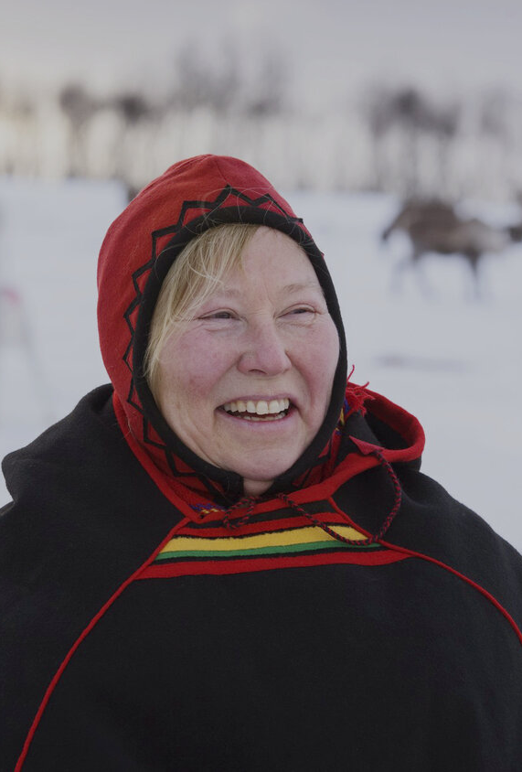
Cultural and Ethnic Identity
Population: 10 million people
Ethnic Identity:
Indigenous people: Swedes with Finnish and Sami minorities
Religion:
87% Lutheran
13% Roman Catholic, Buddhist, Baptist, Orthodox, Muslim, Jewish
Sami People
Indigenous people to parts of Norway, Sweden, Finland, and Russia
Notes:
https://www.commisceo-global.com/resources/country-guides/sweden-guide
https://www.britannica.com/topic/Sami
Image: https://www.benkandbo.com/journals/2020/2/6/sami-people-of-the-north

Slide 4
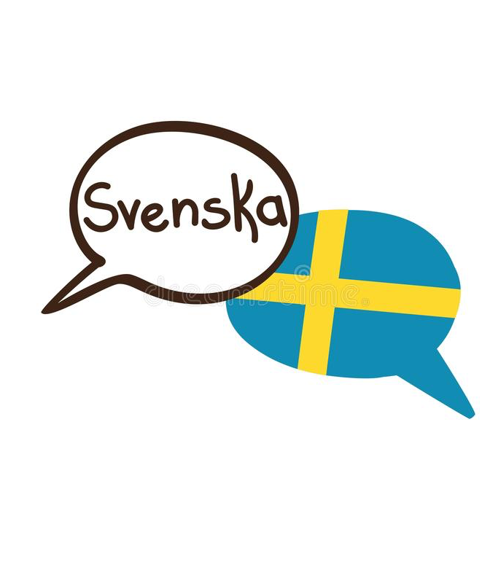

Communication
Languages spoken:
Official Language: Swedish
Minority Languages: Finnish and Saami (spoken in Northern Sweden)
English: About 80% of Swedes speak fluent English
Nonverbal Communication
Swedes respect their personal space, and rarely engage in physical touch in public settings
Hand gestures are not very common or used excessively in Sweden
Key phrases
Hej! – Hello!
Välkommen! – Welcome!
Hej, jag heter … – Hello, my name is …
Jag pratar inte svenska. – I don’t speak Swedish.
Notes:
https://www.tripsavvy.com/things-not-to-do-in-sweden-1626790
https://hejsweden.com/en/basic-swedish-phrases-words-sentences/
https://culturalatlas.sbs.com.au/swedish-culture/swedish-culture-communication
Images:
https://www.dreamstime.com/vector-illustration-two-hand-drawn-doodle-speech-bubbles-national-flag-sweden-written-name-swedish-language-image109521279
https://leadershipflagship.com/2018/06/26/what-happened-when-i-forced-my-american-colleagues-to-take-coffee-breaks/

Slide 5

Family Relationships
Family relationships are important in Sweden, but there are very diverse family styles
Gender equality is much more common in Sweden
Work – it is very uncommon for women to be stay-at-home-moms, unless on maternity leave
"Fredagsmys"
"Cozy Fridays" - these are when Fridays are spent with your close family and friends staying home and playing games
Family activities
Many families are active and go hiking, walking, fishing, or boating together
Notes:
https://www.afsusa.org/countries/sweden/#afs-nav-people
Images -
https://www.purewow.com/wellness/swedish-fredagsmys

Slide 6

Food Practices
Fika
Fika is a common time for people to gather and get together for a social hour in the middle of the day
It is often during afternoon teatime
People may meet at a local café or at their homes for coffee and a pastry
Common food
Lingonberry jam – this is a very common condiment which is often used similarly to ketchup in the United States
Prinsesstaria – these princess cakes are a delicate pastry found in Sweden
Fish – the Baltic sea is right near by, so Baltic herring are very common
Notes:
Information https://sweden.se/culture/food/10-things-to-know-about-swedish-food
Image - https://foodandjourneys.net/wp-content/uploads/2021/09/Fika-Swedish-Tradition-PIC1.jpg

Slide 7
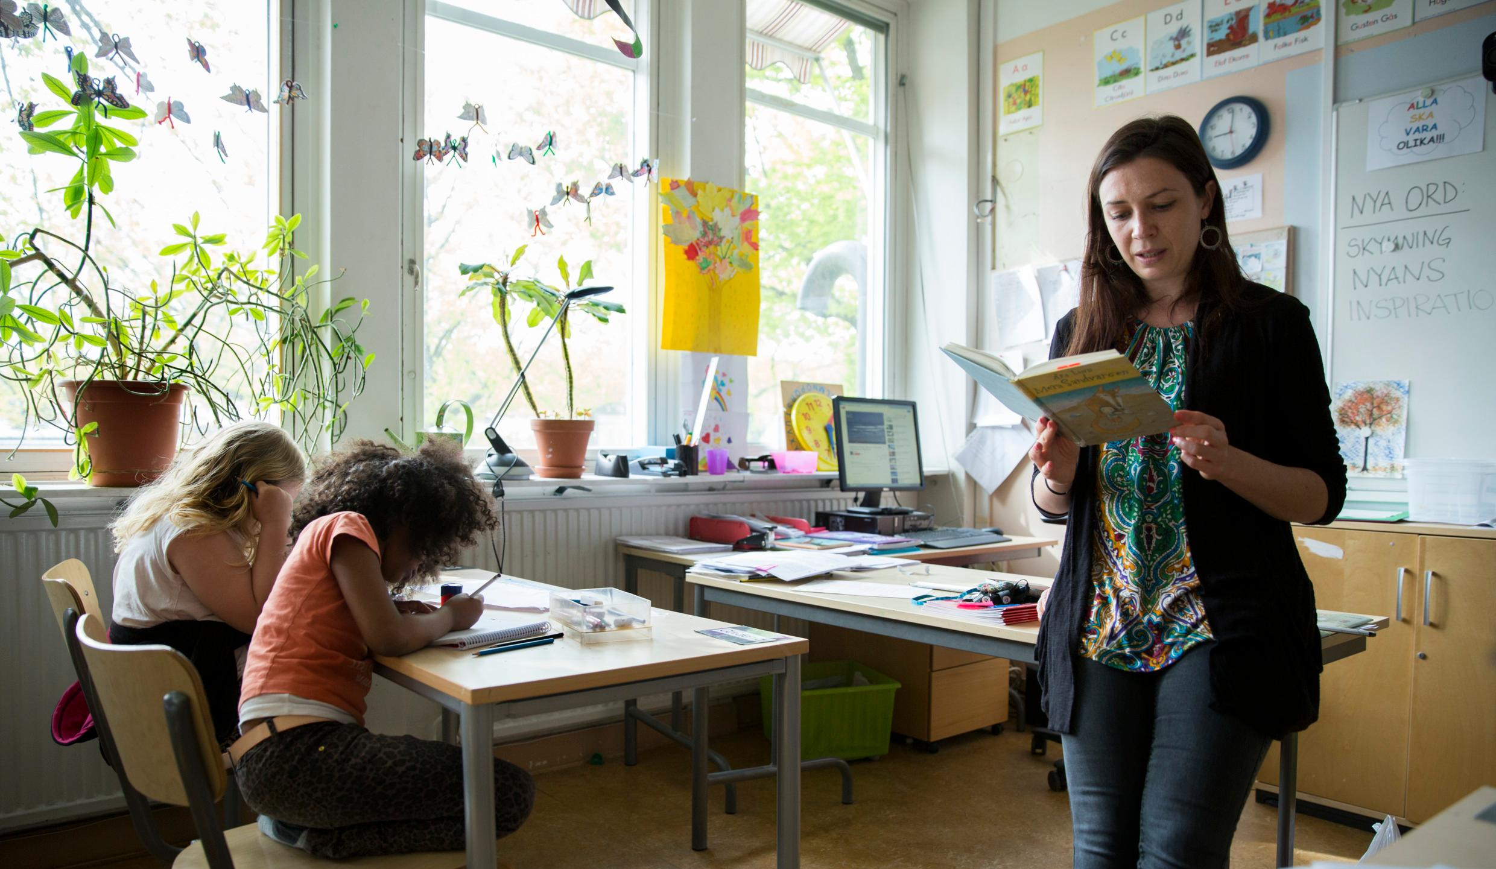
Activities of Daily Life
Sweden is a more socialism-based country, their higher taxes allow for more government offered programs
Schooling
Schooling is common and free for all children in Sweden
Forskoleklass – preschool, year 0
Lagstadiet – years 1 – 3
Mellanstadiet – years 4 - 6
Hogstadiet – years 7 – 9
Childcare
Children 6 – 13 years old are offered free care before and after school hours
Notes:
Information - https://sweden.se/life/society/the-swedish-school-system
Image - https://sweden.se/life/society/the-swedish-school-system

Slide 8
Health Practices
- Sweden’s healthcare system is funded by taxpayer funds
Swede’s lifespan
The average life span of Swedes is growing every year, with the average male lifespan being 80.6 years and 84.29 for females. This shows the overall health of their community, but is also changing the demand of healthcare professionals and leading to more geriatric care
Decentralized healthcare
Healthcare in Sweden is decentralized, meaning that decisions are often made from the lower levels of the government
Decentralized healthcare is regulated by the Health and Medical Service Act
The National Board of Health and Welfare is under the Ministry of Health and Social Affairs which oversees the healthcare system
Having a government-based healthcare allows for high quality of care, but may also lead to longer wait times

Slide 9
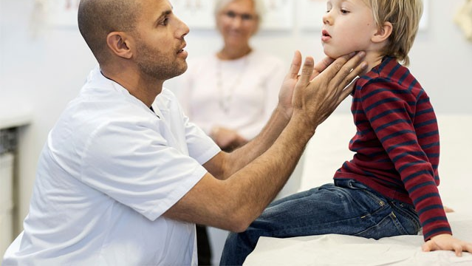
Illness Beliefs
Swedes are very self-controlling when it comes to their health
Active lifestyles and healthy diets are a part of almost everyone’s lives, and the overall culture in Sweden
Socialism effecting healthcare
Because Swedes pay such high taxes for minimal healthcare expenses, many citizens take advantage of all of the public health programs available to them, which increases overall health
Cancer screenings, physical exercise programs, and smoking prevention are all public health initiatives led by the government health agencies which help boost overall wellbeing
Notes:
Information - https://doi.org/10.1016/S0020-7489(03)00020-8
https://www.symbiocare.org/how-sweden-achieved-world-class-medical-and-social-care/
Image - https://www.symbiocare.org/how-sweden-achieved-world-class-medical-and-social-care/

Slide 10
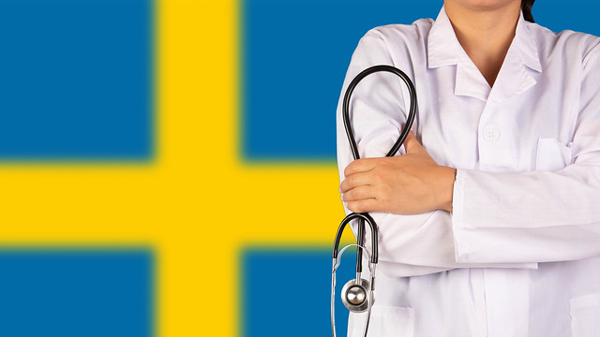
Symptom Management
The active lifestyle and overall health of Swede’s is generally high, allowing for a very long average lifespan
The high taxes in Sweden also allows for easy access to healthcare which is commonly covered by the taxes you pay
Opioid use
As seen with many other countries, opioid use has been increasing in Sweden as well
Drug related deaths have increased from 7.6 / 100,000 in 2006 to 11.6 / 100,000 in 2017, most of which being opioid caused
Notes:
Information - https://harmreductionjournal.biomedcentral.com/articles/10.1186/s12954-019-0354-y
Image - https://borgenproject.org/wp-content/uploads/Health-Care-in-Sweden.jpg

Slide 11
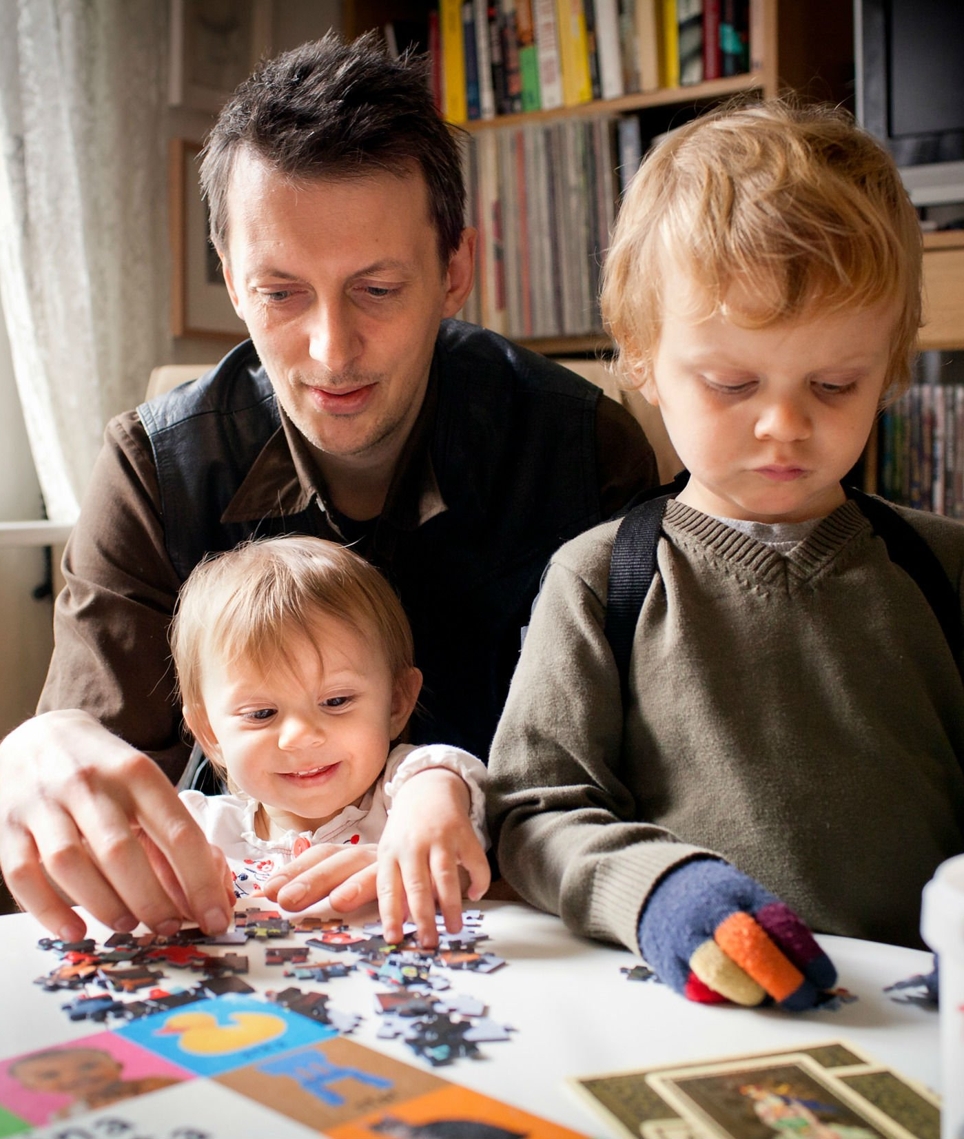
Birth Rituals and Pregnancy
Sweden has some of the best protective childcare laws in the world. They put a strong focus on allowing parents to take time off from work to take care of their children. Leave from work is also equal and allowed for both mothers and fathers.
Maternity and paternity leave
Either parent is allowed time off from work until the child is 18 months old
Either parent may reduce their workload by 25% for 8 years
Paid leave for both parents is 480 days, 60 of these days must be used by the “minority parent”
This is used to encourage make presence in the child’s life
Midwives and mortality rates
Mortality rates of women during childbirth are very low comparatively, mostly due to the common practice of midwives
Less than 3 / 1,000 babies and less than 4 / 100,000 women die from childbirth
Notes:
Information - https://sweden.se/life/society/healthcare-in-Sweden
Image - https://pbs.twimg.com/media/DUJSCB5UQAADwdf?format=jpg&name=4096x4096

Slide 12
Wait Times in Sweden
I chose to focus on the healthcare issue of the long wait times in Sweden. Due to their centralized universal healthcare system, they have seen high quality care, expect the wait times are becoming too ridiculous. Compared to other countries, Sweden is at the top of the list for how long it can take to seek medical care.
My solution to this is to decrease the maximum time frames on seeking care for each specialty. With an increase in general care physicians and a decrease in the guaranteed wait time, care should be overall increased in the country. Sweden has already started to implement maximum wait times for certain procedures, but if we set a time limit for each procedure, medical centers will be held to that responsibility and fined by the government if they are unable to stick to those numbers.

Slide 13
Research Article 1 – Swedes Enjoy Worldclass Healthcare – When they get it
MedicalxPress
https://medicalxpress.com/news/2018-09-swedes-world-class-healthcarewhen.html

Slide 14
Overview of Wait times in Sweden
Overview
Sweden has one of the overall most highly rated healthcare systems in the European Union, spending high amounts of money on their "decentralized universal healthcare system for everyone." While the quality of care is high, the wait times for patient care are ever-growing in Sweden.
Expectations versus Reality
According to Swedish law, patients should wait no more than 90 days for surgery or to see a specialist. In reality, 1/3 patients wait longer than 90 days
The law for general health practitioners is a maximum of 7 days wait time, which is the second longest wait time in the European Union.
Notes:
Swedish healthcare is typically known worldwide for its quality and the overall health of the nation. Sweden is recorded to have the 5th highest life expectancy in all of Europe. However, because this is a public system which is different than our healthcare system in the United States, wait times are often much longer. These wait times can often lead to worsening symptoms and pain.

Slide 15
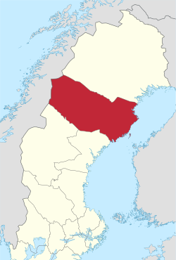
Prevalence and Cost
Prevalence
Geography – Access to healthcare changes greatly based on location in Sweden. Northern regions often see longer wait times compared to Southern counties closer to the capital.
Cost to the country
Sweden spends over 11% of its shared GDP on healthcare
They are the 3rd highest spending country on healthcare in the European Union
Swedish citizens spend over 50% of their income on taxes which fund federal programs like the healthcare system
Notes:
Prevalence – One example of these varying wait times is seen with prostate cancer surgery. The country average wait time for this surgery is 120 days, but as you move into more northern counties like Vasterbotten, the wait times average jumps up to 271 days.
Image – The image to the left, shows a map of the 21 different counties in Sweden, highlighting in red where Vasterbotten is. The capital, Stockholm is more southern and where more efficient healthcare is typically found. As you move more north, the landscape becomes more rural, and access to healthcare becomes more of a challenge.
Link to image: https://en.wikipedia.org/wiki/Västerbotten_County

Slide 16
Research Article 2 – Health Care Waiting List Initiatives in Sweden
By Ragnar Lofgren
https://www.fraserinstitute.org/sites/default/files/HealthcareInitiativesinSweden.pdf

Slide 17
How did Sweden try to fix the long wait times?
Additional compensation for hospitals which agree to work overtime
Compensations from the Federation of County Counsils
This method only reduced wait times minimally
Focus was put on non-urgent surgeries
Monitoring six different aspects of local hospitals, they tried to record trends and data to better allocate resources
Cardiology, ophthalmology, gynecology, orthopedics, urology, surgery
Notes:
From 1987 – 1997, Sweden set an initiative to try and reduce the long wait times in the country to try and see healthcare professional. One thing to note is that this initiative started in 1987, and we are still seeing many arguments over the topic, with ever long wait times.
Additional compensation for hospitals which agree to work overtime
With this method, focus was put on hospitals to use this money to perform non-urgent surgeries. These are the types of surgeries which would often have extremely long wait times, because urgent emergency surgeries typically take the priority.
Non – urgent surgeries here include coronary artery bypass surgeries, hip replacements, and cataract surgeries.
Monitoring six different aspects of local hospitals, they tried to record trends and data to better allocate resources
- This was in effort to reduce the bottleneck effect of resources and to try and more properly redistribute resources. The results of this varied by hospital for wait times.
- This initiative took place in 1989.

Slide 18
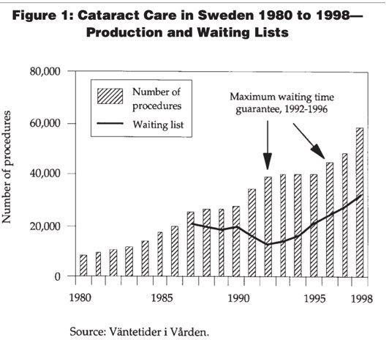
How did Sweden try to fix the long wait times? - Maximum Waiting Times
Creation of a maximum waiting- time guarantee
Patients waiting for one of 12 different procedures will be offered treatment within 3 months
If the patient was not treated within 3 months, the hospital was required to pay for the procedure to be done at another hospital
After time, the guarantee no longer held true and this dissipated
Notes:
Creation of a maximum waiting- time guarantee
- This policy was initially successful, but then the waitlist started to grow too long and the 3 month guarantee was not being met.
- This was active from 1991-1996.
- the figure on the right, shows the change in wait times for cataract surgery before and after the maximum waiting time gaurantee was in place.

Slide 19
Research Article 3 Maximum waiting - time guarantee – an attempt to reduce waiting lists in Sweden
By M Hanning
DOI: 10.1016/0168-8510(95)00791-1

Slide 20
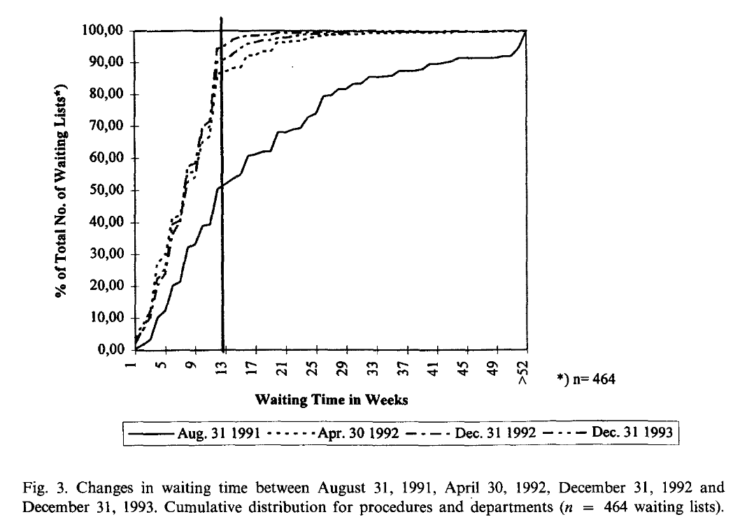
Overview of the Maximum Waiting – Time Guarantee
In 1992 the Swedish Government and the Federation of County Council creating the Maximum Waiting – Time Guarantee
Patients were guaranteed to wait no more than 3 months for 12 denoted procedures
70 million USD were initially put into this program, but after funding ran low the waitlists again grew long and this was no longer feasible

Slide 21
Negative outcomes of the guarantee
It was assumed that the 3 month guarantee would promote healthcare workers to refer patients which they cannot treat in an appropriate amount of time to another hospital which can. This was not the case, as few hospitals referred patients to other locations.
Instead of becoming more efficient with their hospital resources, hospitals began to expand their offerings rather than recommending them to neighboring hospitals

Slide 22
Research Article 4 - Challenges to ensuring valid and useful waiting time monitoring – a qualitative study in Swedish specialist care
By David Ebbevi, Henna Hasson, Knut Lonnroth, and Hanna Augustsson
https://bmchealthservres.biomedcentral.com/articles/10.1186/s12913-021-07021-y

Slide 23
Assessing Wait Time Validity
This study investigated whether the benefits of wait times in a healthcare setting were worth all of the negatives resulting from them
Benefits - "reduces the risk of expensive hospital services being underutilized," "might avoid potential treatment risks," etc.
Method – they interviewed 28 different health care professionals on their opinion on the wait times and accessed how it effected their services
Hospitals were chosen in the Stockholm region of Sweden, and picked to represent a wide range of population and funding in that region.
A waiting time registry was used for each health care visit and interview, to record data

Slide 24
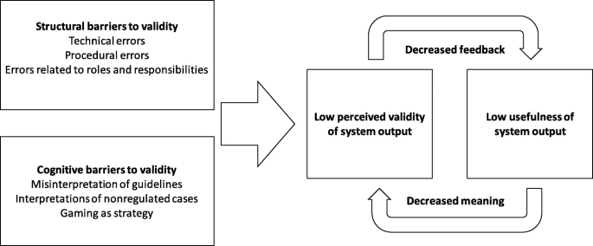
Waiting Time Data Control
In Stockholm, waiting times are recorded in two different databases
The waiting time registry and The Supply Service Database
Purpose of recording wait times
Policy Level – for reimbursement and economic sanctions between providers
Clinical Level – production and planning wait times for patients
Results
Their main finding was that the wait times being promised were not valid or accurate, with validity being the main barrier in this healthcare system.

Slide 25
Research Article 5 -Telemedicine: how Sweden is reducing waiting times for Parkinson’s treatment
https://parkinsonslife.eu/telemedicine-how-sweden-is-reducing-waiting-times-for-parkinsons-treatment/

Slide 26
Telehealth Visits Reduce Wait Times
In use
Telehealth visits for referrals in Parkinson's Disease are now in use and have reduced the wait times from six weeks down to one week.
Who uses them?
Parkinson's specialists are using these video calls to consult with other neurologists to confirm patient's diagnosis
Spread of information
These calls are spreading information from high level neurologists to general physicians and Parkinson specialists

Slide 27
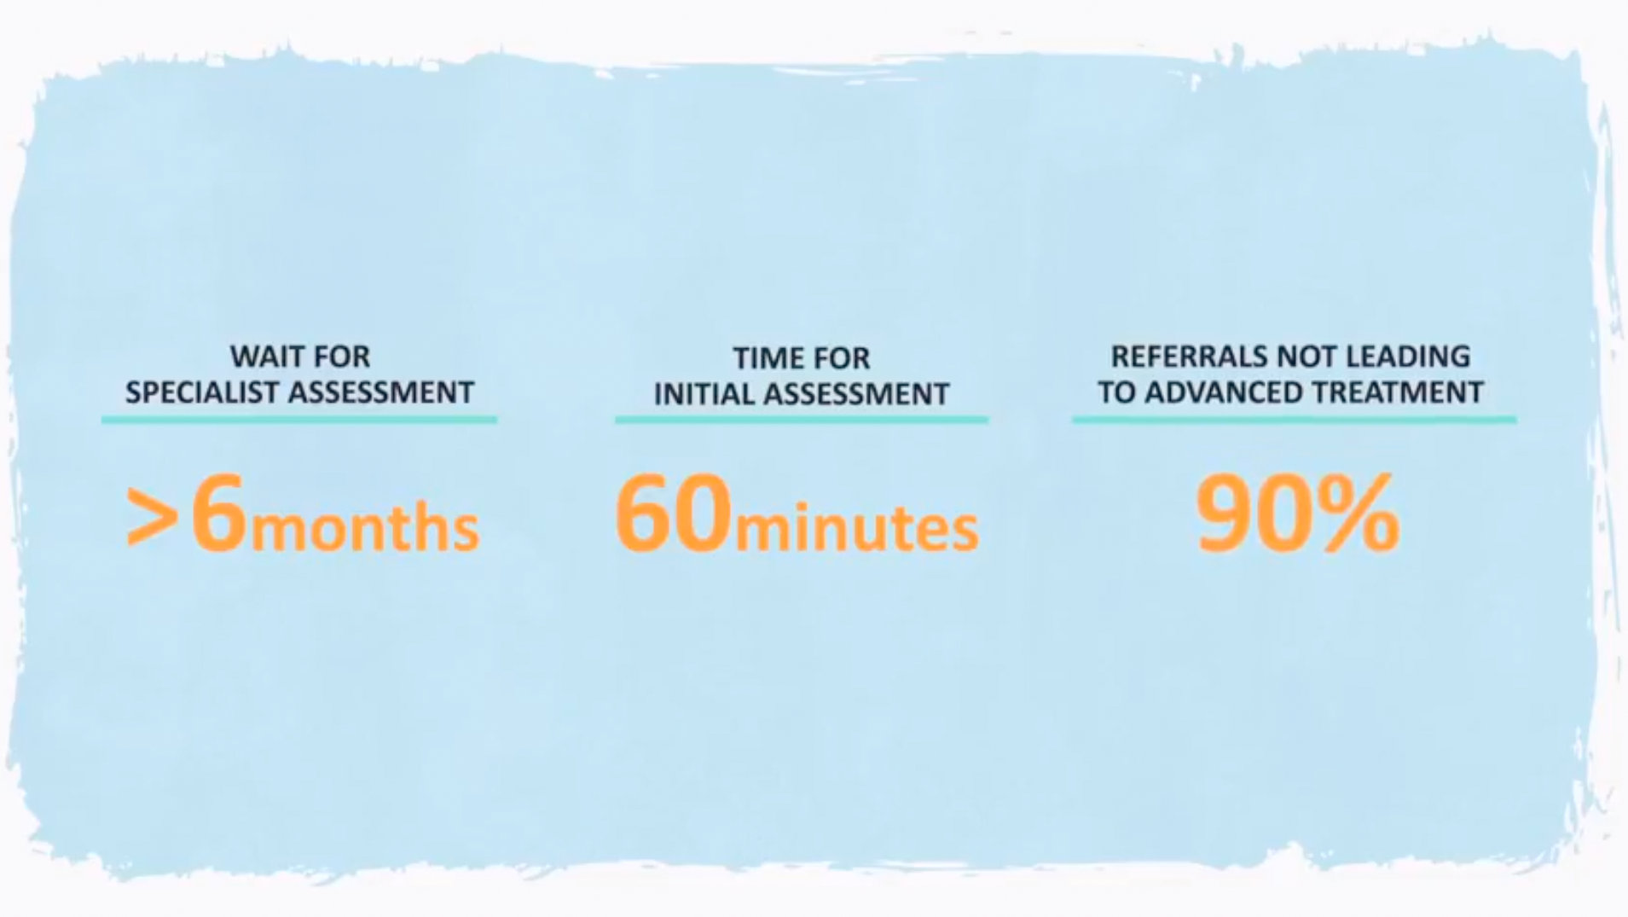
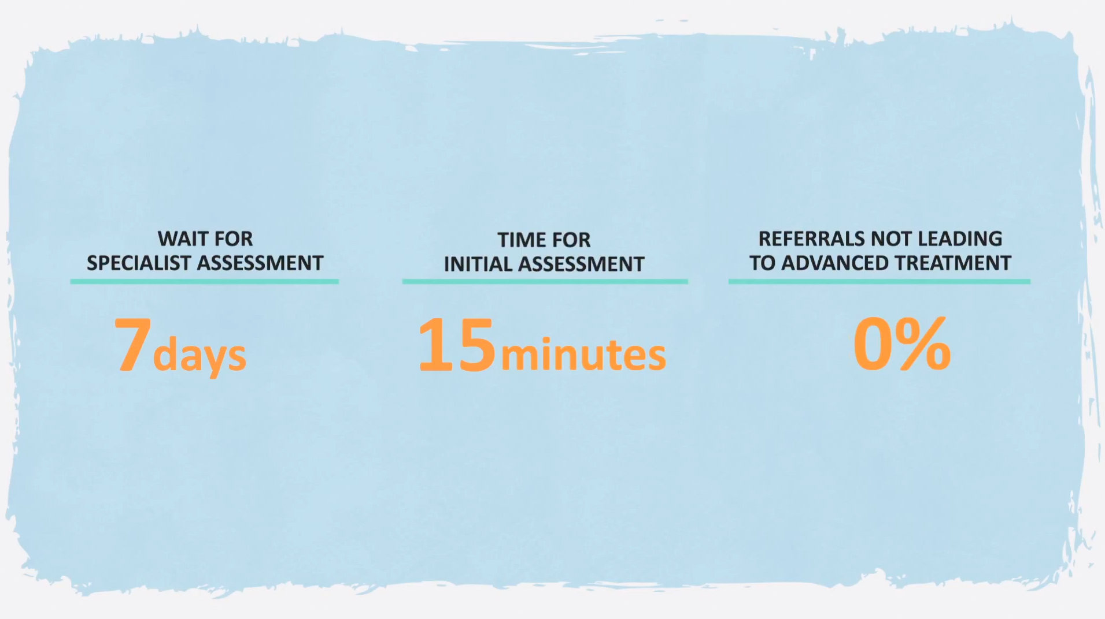
Results
Before consultive neurology
Locations where telehealth consulting is already occurring
Stockholm, Uppsala, Umea, Linkoping
Statistic results are shown in the charts
After consultive neurology

Slide 28
Proposal
My proposal to fix the problem of long wait times in Sweden is to add maximum wait times for all procedures and healthcare visits. This goes for dental cleanings, selective surgeries, emergency procedures, etc. We have already seen the addition of maximum wait times for particular procedures, but their implementation was flawed.
In order to make this successful, I think it would be best for each hospital to compile a list of procedures or systems of the body which they would like to become the specialists in. They can then become very efficient with these procedures, as they know what to expect.
Another part of my proposal would go to increasing funding for general primary care physicians. Then, when patients go to their primary care physician, the doctor would know exactly where to direct them and because that hospital specializes in a few procedures hopefully the wait time would be much reduced.

Slide 29
Proposal
We could increase the number of general physicians by offering an equal salary to those in specialized positions, because that is one of the main reasons why doctors choose to specialize in a field.
By increasing the number of primary care physicians and having more clearly defined specialized hospitals for those primary care physicians I think that these hospitals would be better equipped with a clear path for patients to reach their care within newly defined maximum wait times.

Slide 30
References –
“10 Things to Know about Swedish Food.” The Swede in London, 11 June 2015, https://thebritishswede.wordpress.com/2015/06/11/10-things-to-know-about-swedish-food/.
Afs-Usa. “Sweden: Exploring Swedish Culture: Learn with AFS-USA.” AFS, https://www.afsusa.org/countries/sweden/#afs-nav-people.
Andersson, Lisa, et al. “Investigating Opioid-Related Fatalities in Southern Sweden: Contact with Care-Providing Authorities and Comparison of Substances - Harm Reduction Journal.” BioMed Central, BioMed Central, 9 Jan. 2020, https://harmreductionjournal.biomedcentral.com/articles/10.1186/s12954-019-0354-y.
“How Sweden Achieved World-Class Medical and Social Care.” Symbiocare, 22 June 2016, https://www.symbiocare.org/how-sweden-achieved-world-class-medical-and-social-care/.
Kamann, Matthias, et al. “Basic Swedish Phrases, Words & Common Sentences - for Your Trip to Sweden.” Hej Sweden, 10 Mar. 2021, https://hejsweden.com/en/basic-swedish-phrases-words-sentences/.
Last updated on 10 November 2021. “Taxes in Sweden.” Sweden.se, 12 Nov. 2021, https://sweden.se/life/society/taxes-in-sweden.
Last updated on 30 November 2021. “The Swedish School System.” Sweden.se, 30 Nov. 2021, https://sweden.se/life/society/the-swedish-school-system.
Last updated on 30 November 2021. “The Swedish School System.” Sweden.se, 30 Nov. 2021, https://sweden.se/life/society/the-swedish-school-system.
Last updated on 30 November 2021. “The Swedish School System.” Sweden.se, 30 Nov. 2021, https://sweden.se/life/society/the-swedish-school-system.
Mapes, Terri. “15 Things Not to Do When You Travel to Sweden.” TripSavvy, TripSavvy, 18 Apr. 2020, https://www.tripsavvy.com/things-not-to-do-in-sweden-1626790.
Pier. “Swedish Culture.” Cultural Atlas, https://culturalatlas.sbs.com.au/swedish-culture/swedish-culture-communication.
“Religious and Cultural Distance in Beliefs about Health and Illness in Women with Diabetes Mellitus of Different Origin Living in Sweden.” Science Direct, https://doi.org/10.1016/S0020-7489(03)00020-8.
“Sami.” Encyclopædia Britannica, Encyclopædia Britannica, Inc., https://www.britannica.com/topic/Sami.
“Sweden - Culture, Etiquette & Business Practices.” Commisceo Global Consulting Ltd., https://www.commisceo-global.com/resources/country-guides/sweden-guide.
Image Citations – Are in the notes of each slide as well

